Slide 1
Astronomy Transients
ASTRAL EIGHT
Chirag Rathi , Elise P, Martina Cadiz , Sara Federle , Sherelyn Alejandro
TA- Paula Llanos

Slide 2
Project Overview
Transients from ZTF
~ 40,000 objects and ~44 features
Exploratory data analysis
Multiclass supervised classification
Compare the performance of multiple machine learning models
Notes:
Some general overview of the project

Slide 3
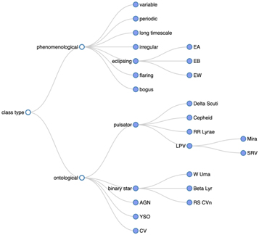
Data from Zwicky Transient Facility
Observes entire Northern Sky since 2018
Scans every 2 days in the g, r, and i filters
1.2 m Samuel Oschin Schmidt telescope
Magnitude limit: m_{r}=20.5
Obtained Data for Billions of Sources
Roestel 2021

Slide 4
The Hurdles of Big Data
Supervised Machine Learning can help us analyze our large sample of data with known classifications more efficiently, allowing us to understand our sample even better
Notes:
Motivation

Slide 5
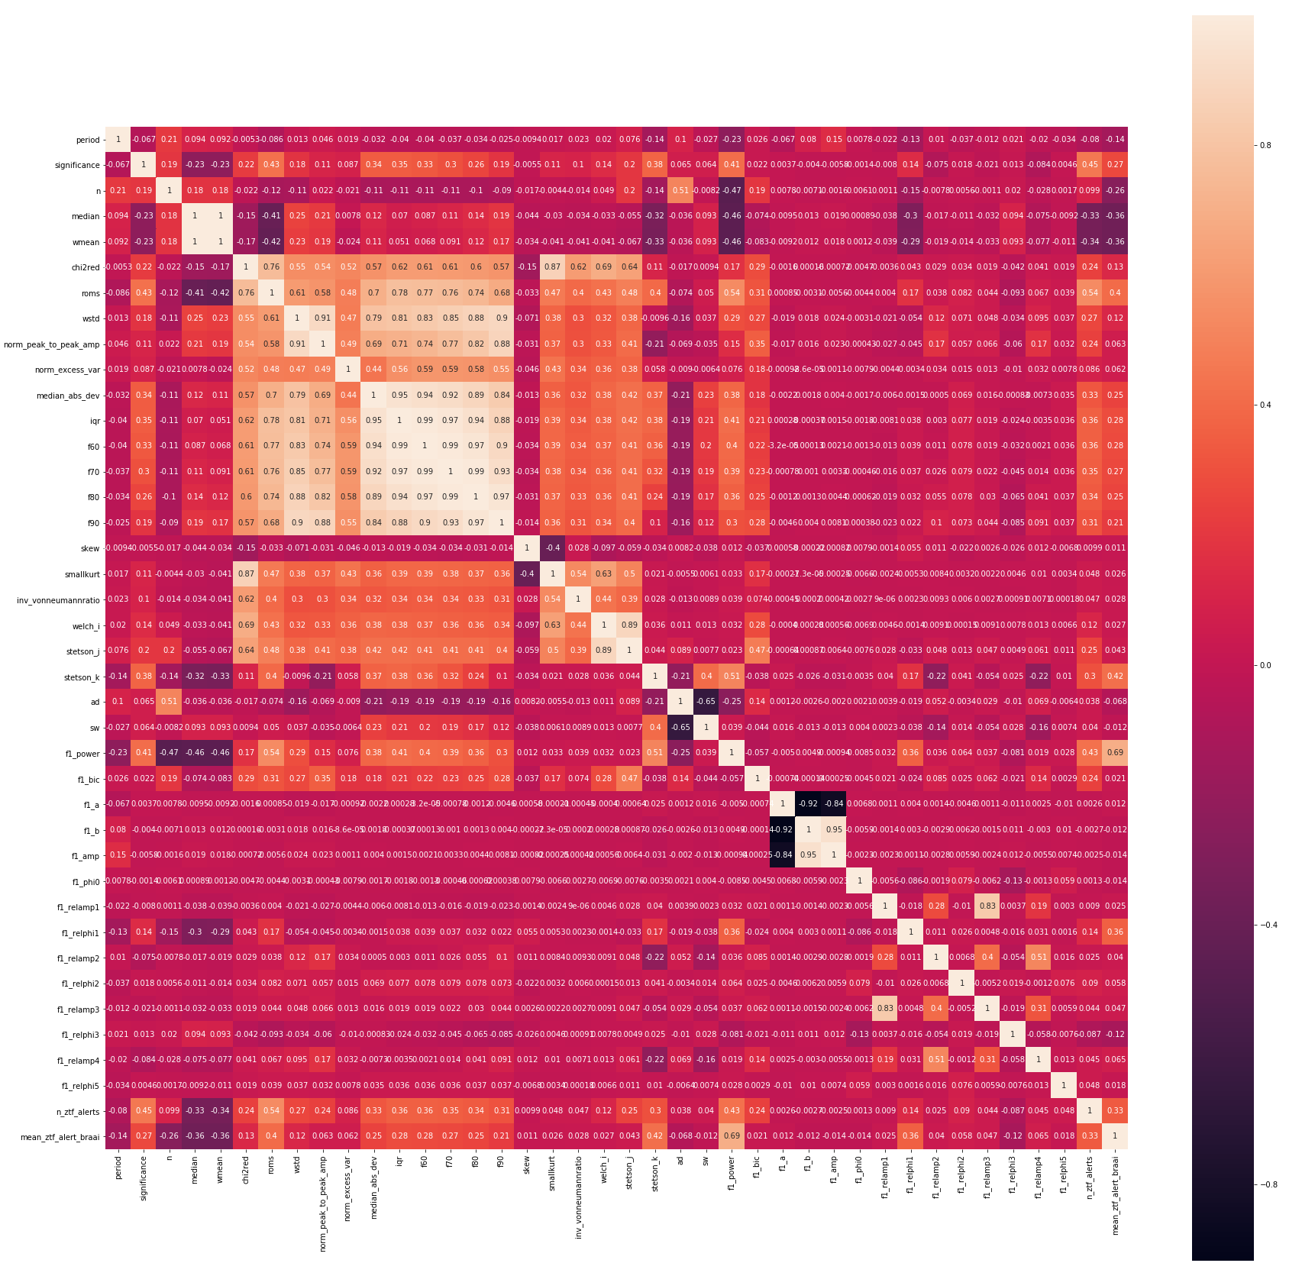
Exploratory Data Analysis: Correlation matrix
SF
The matrix shows the correlation among the features
Orange denote strong correlation, whereas darker colors denote no correlation

Slide 6
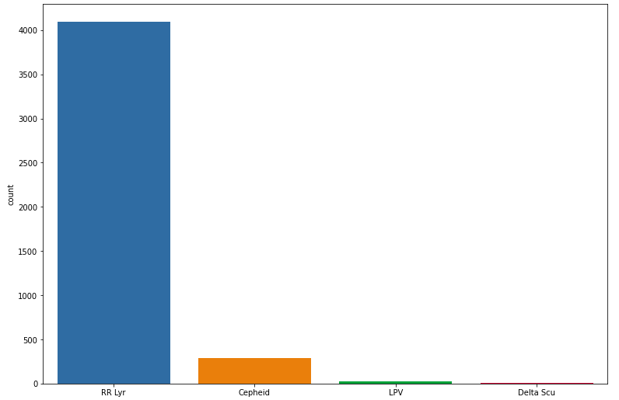
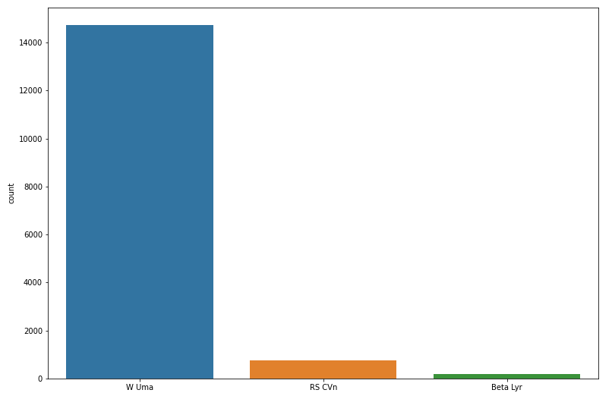
Exploratory Data Analysis: Pulsators and Binaries
SF
Count Plots for the different classes of pulsators (left panel) and binaries (right panel)

Slide 7
Dealing with Data Imbalances
Stratified sampling
Data augmentation techniques (SMOTE, random sampling )
Dimensionality reduction methods:
Recursive Feature Elimination
Principal component analysis (PCA)

Slide 8
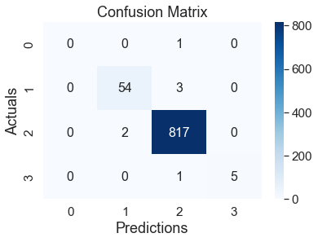
Data Imbalance:
Method 1: Random oversampling or undersampling
Oversampling: produce exact (and random) copies of minority data
until minority = majority.
Undersampling: randomly remove majority data until majority = minority.
Method 2: SMOTE
Synthetic Minority Oversampling Technique.
Uses k-nearest neighbors to mimic data points in the minority class.
Module(s) used: imblearn.over_sampling.smote, imblearn.oversampling.RandomOverSampler
CR

Slide 9
Dimensionality Reduction Methods:
CR
METHOD 1: Recursive Feature Elimination
Too much data is overwhelming.
Hard to focus on anything.
RFE to the rescue! This process eliminates unnecessary features by taking smaller subsets of features and applying it to the training data.
Module(s) used: sklearn.feature_selection.RFE, sklearn.ensemble.RandomForestRegressor

Slide 10
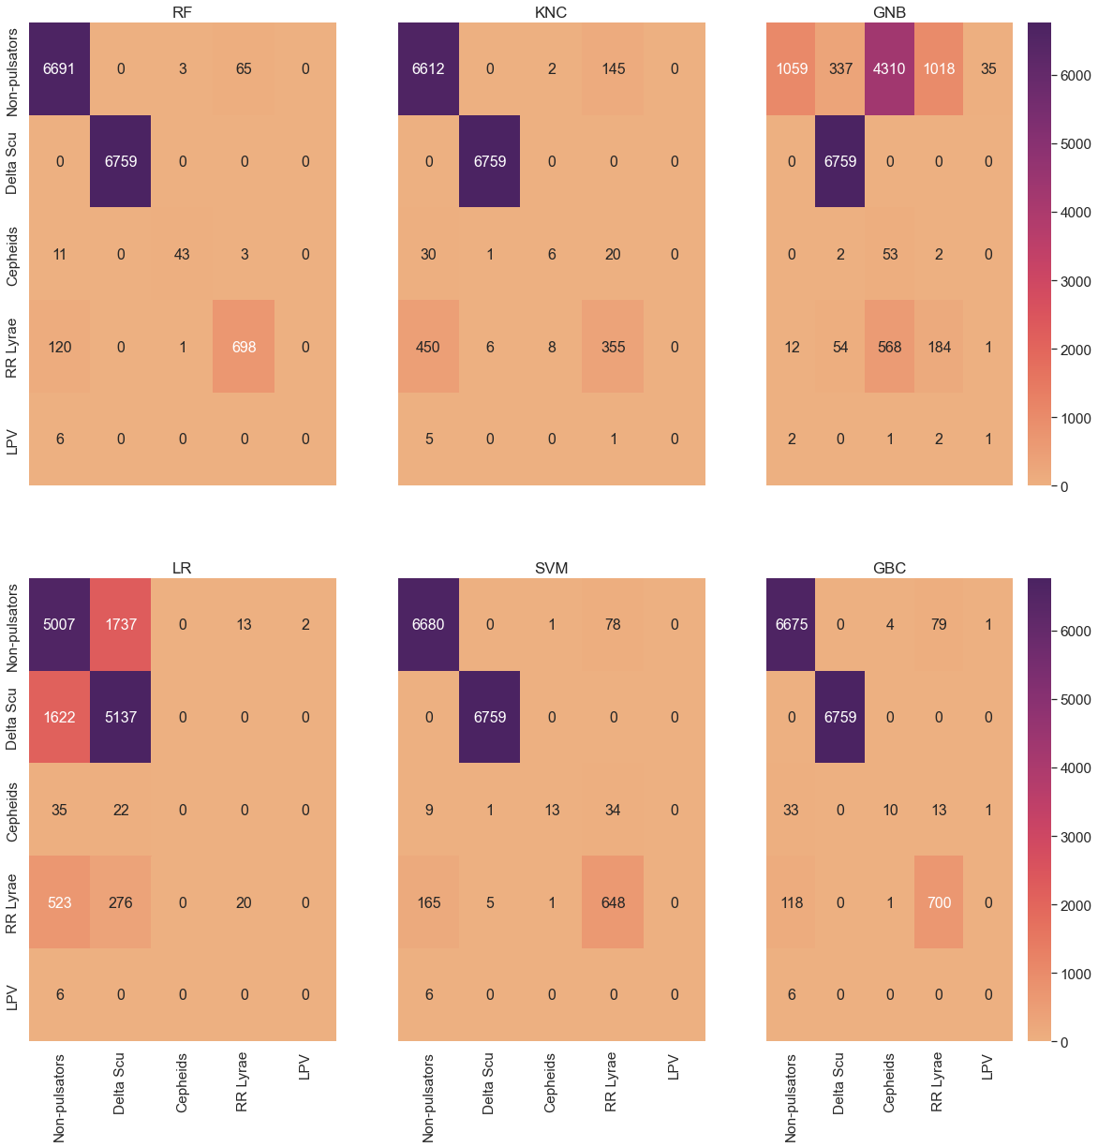
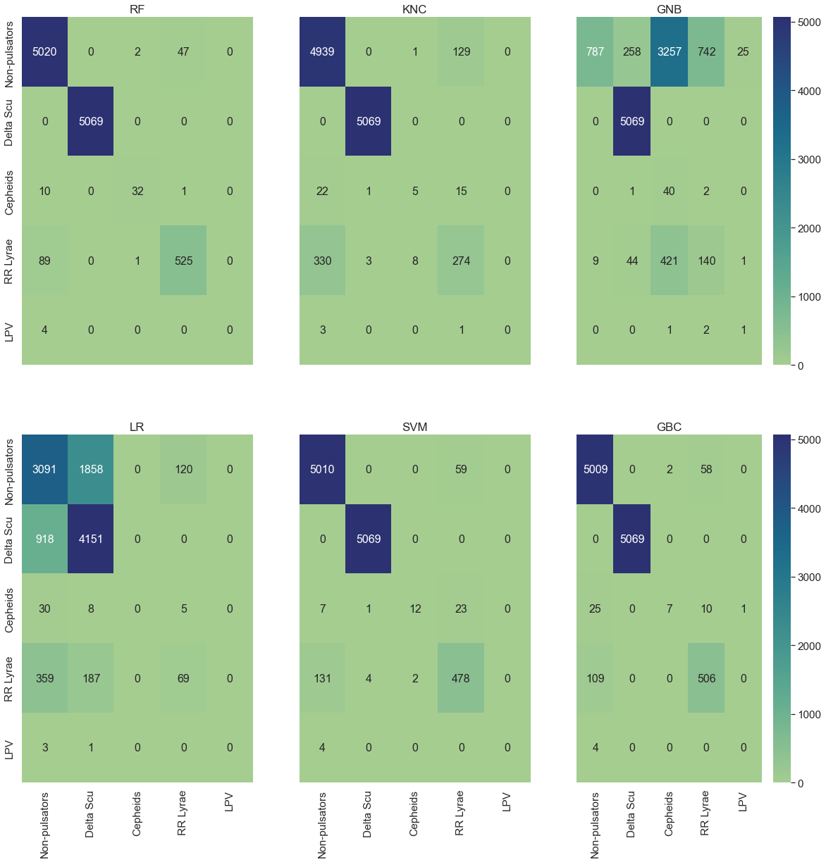
Test size = 20%
Test size = 15%
RFE + SMOTE Results:
CR

Slide 11
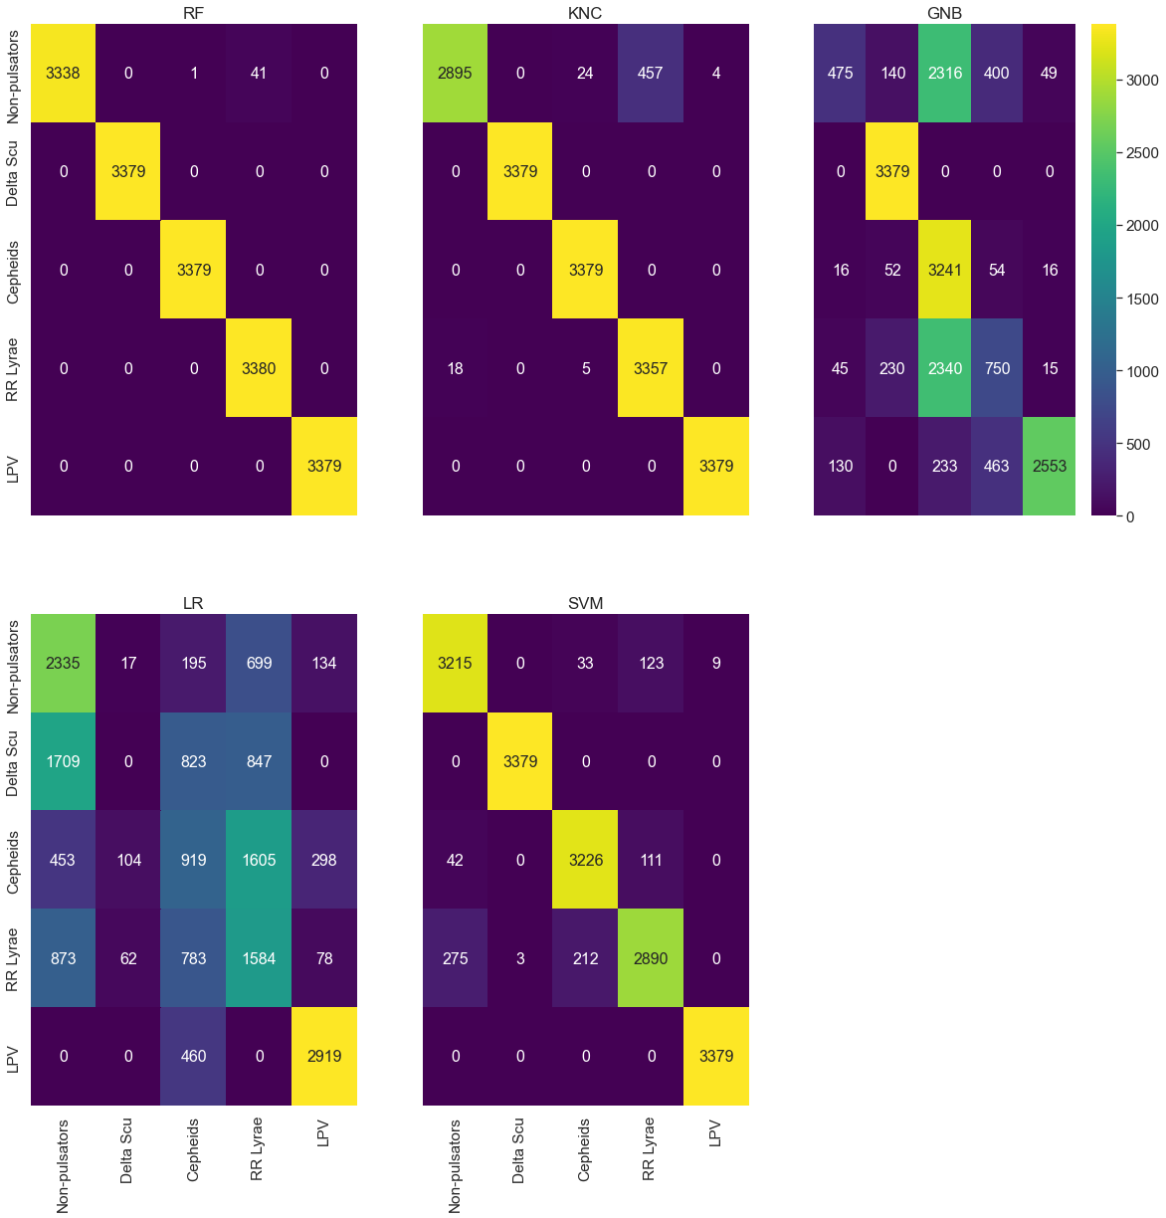
CR
Test size = 10%

Slide 12
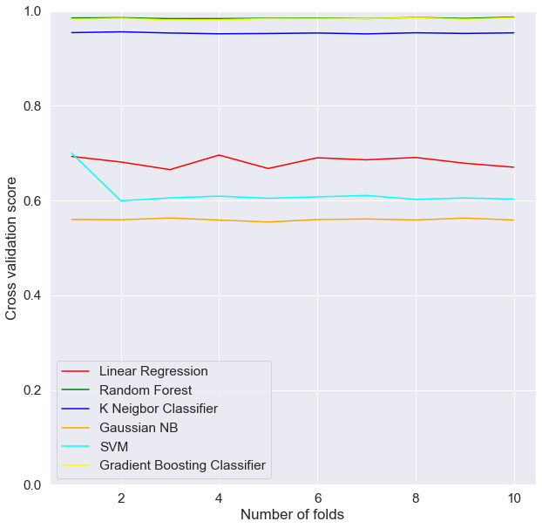
Comparing estimators’ performances
CR
Scoring technique = accuracy
Folds = division of data into n folds
Cross validation score = predictor of performance.
Winner = GBC and RF
NOTE: Stratified folding!

Slide 13
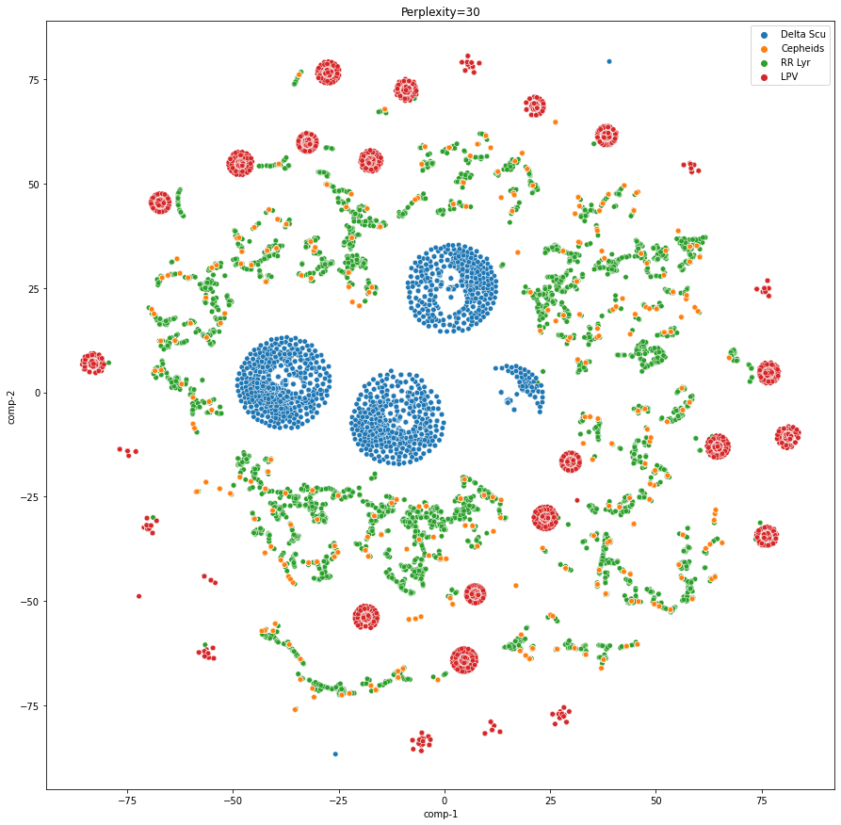
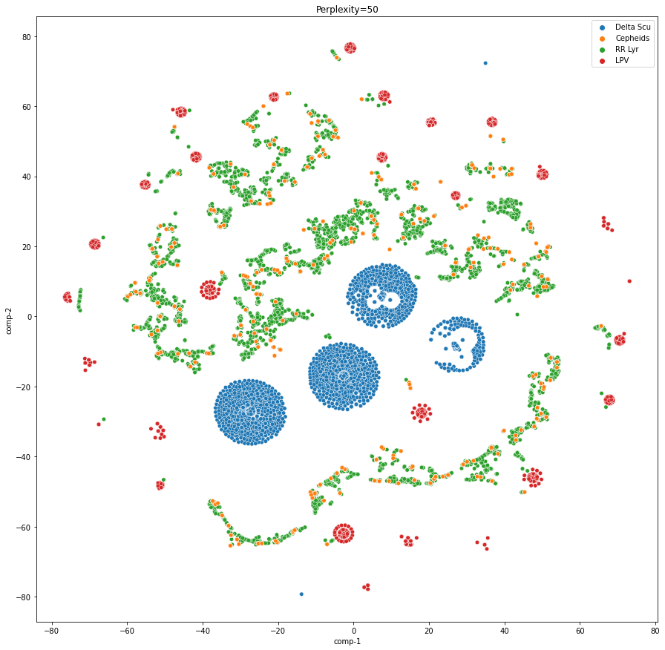
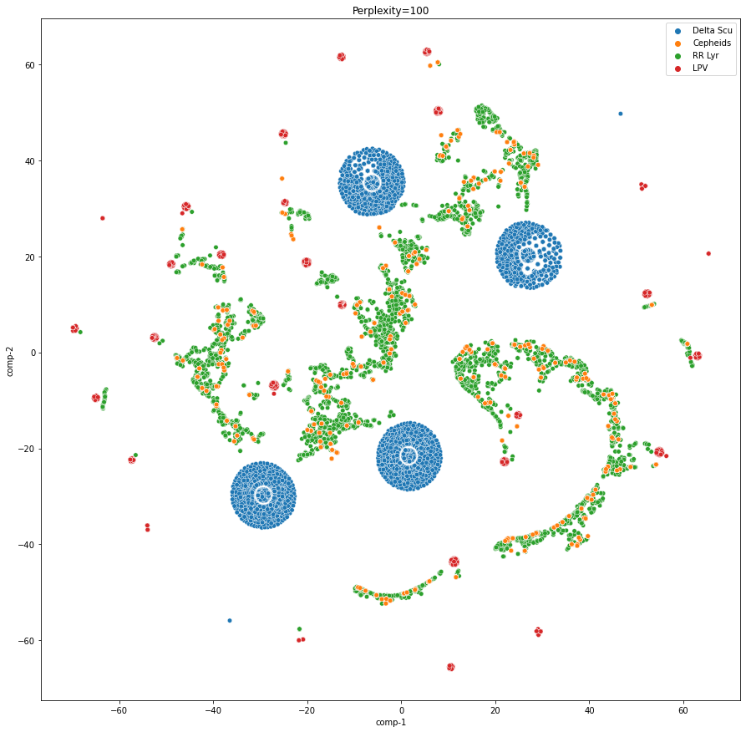
Unsupervised learning: TSNE
CR
Perplexity = 30
Perplexity = 50
Perplexity = 100

Slide 14
Random Forest vs XGBoost
SF
Random Forest
Fits a certain number of decision tree classifiers on various subsamples of the data
Improve predictive accuracy and control overfitting
XGBoost
Implementation of Gradient Boosting
Fit n classes of regression trees on the negative gradient of the loss function
Allows for optimization of differentiable loss function
Confusion matrix ( C )
Evaluates the accuracy of the classification
C_{ij}= number of observations known to be in class i but predicted to be in class j

Slide 15
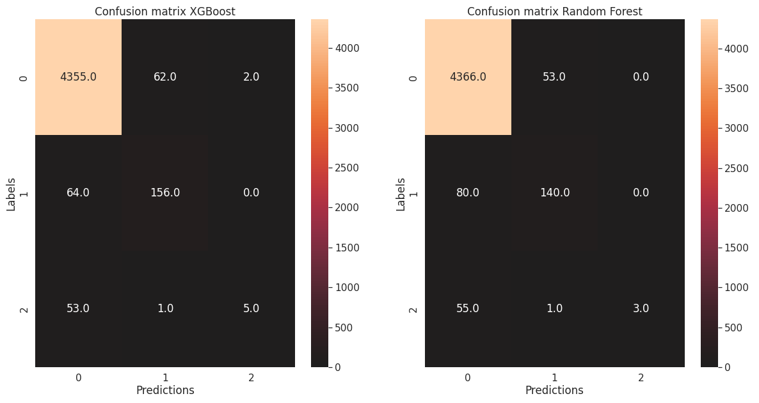
RESULTS
Machine Learning performance: unbalanced case
SF
Confusion matrix for the XGBoost (left panel) and Random Forest Classifier (right panel) in the unbalanced case for the binaries classification. In both cases the test size was 30%. The classes are W Uma (0), RS CVn (1) and Beta Lyrae (2).

Slide 16
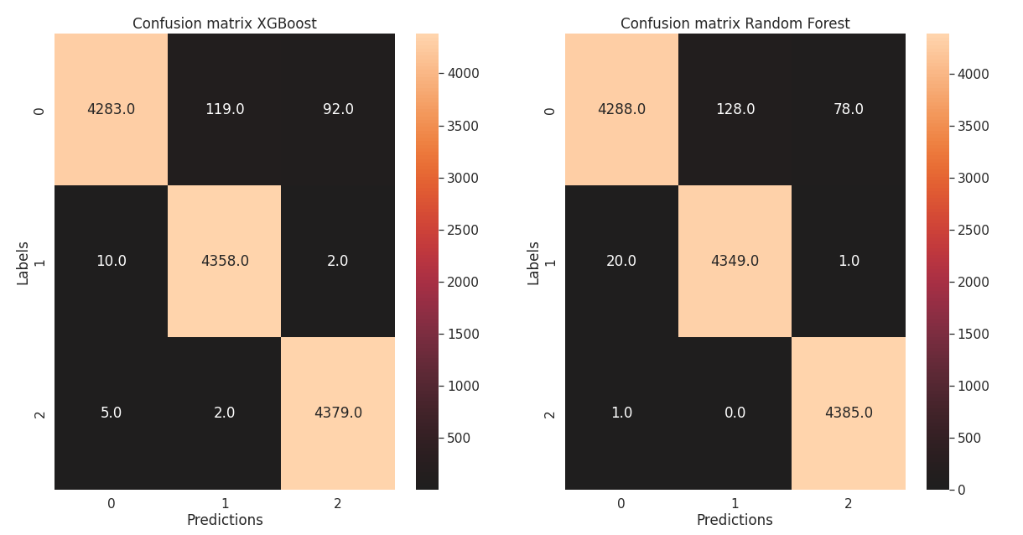
Machine Learning performance: balanced case
SF
Confusion matrix for the XGBoost (left panel) and the Random Forest Classifier (right panel) in the balanced case for the binaries classification. In both cases the test size was 30%. The classes are W Uma (0), RS CVn (1) and Beta Lyrae (2).

Slide 17
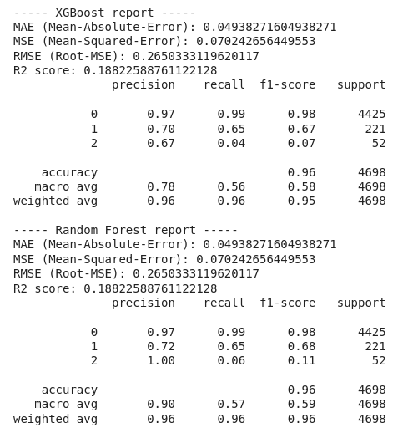
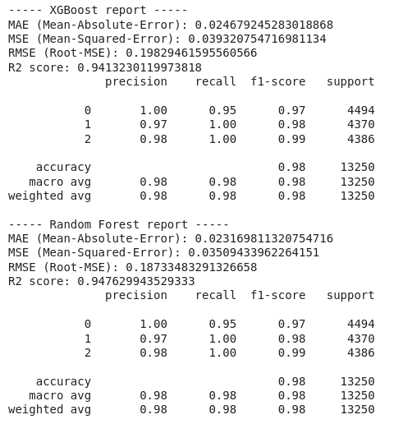
Machine learning: classification reports
SF
Comparison among the classification reports for the unbalanced (left panel) and balanced (right panel) cases. The reports were obtained for the XGboost (top panels) and Random Forest (bottom panels) Classifiers.

Slide 18
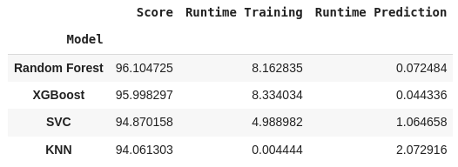
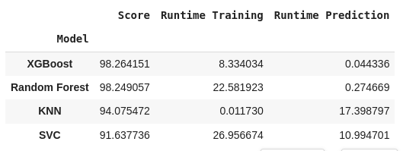
Machine Learning performances: scores and runtimes
SF
Comparison of different Machine Learning methods applied for the binaries classification for the unbalanced (top panel) and balanced (bottom panel) cases

Slide 19
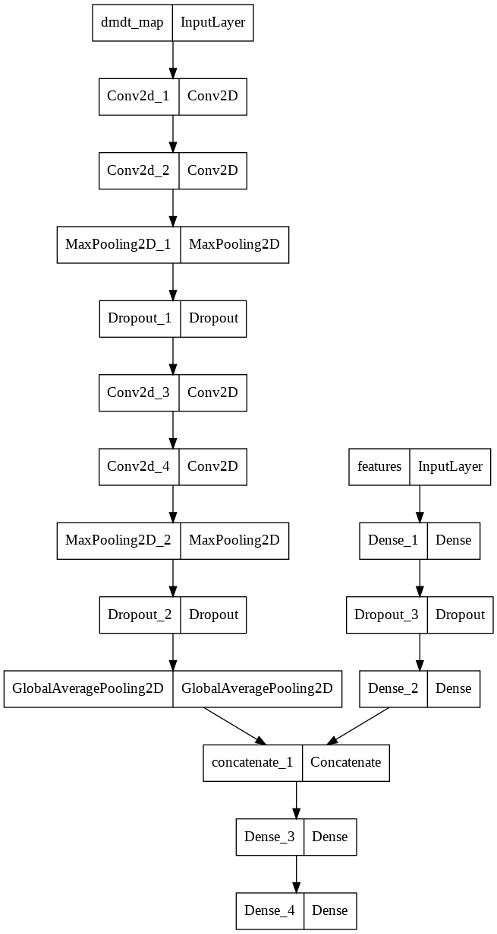
Deep Learning classification
Aim to use the light curves image set
Data preparation
Train set (8K), test set (4K), validation set (2K)
• PCA for dimensionality reduction
• Image resolution 28x28
Training stage
• EarlyStopping w/ 10 of patience
• Dropout
• Time consumed for training: 55.541 seconds
CNN architecture used

Slide 20
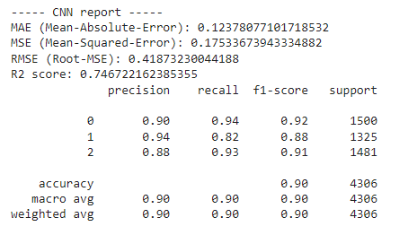
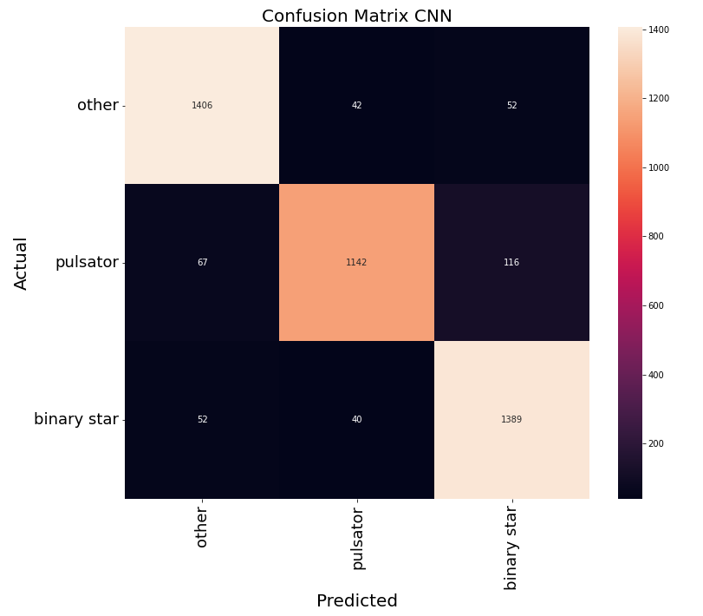
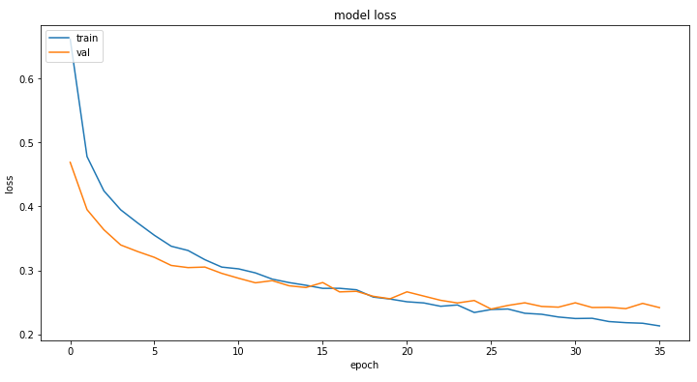
RESULTS
Deep Learning performance
CNN report
Confusion Matrix for the CNN
Learning curve

Slide 21
CONCLUSIONS & FUTURE WORK
RESULTS
Classified the pulsators successfully using RFE process.
Classified binaries with different classification methods → Random Forest and XGBoost gave the best results
The machine learning models presented worked better than the CNN
NEXT STEPS
Need more data for particular sub-classes of pulsators and binaries to improve the classification
Try another data augmentation technique

Slide 22

ACKNOWLEDGMENTS
Thank you to La Serena School For Data Science !
Niharika Sravan and Paula Llanos

Slide 23
REFERENCES
Jan van Roestel, Dmitry A. Duev, Ashish A. Mahabal, Michael W. Coughlin, Przemek Mrόz, Kevin Burdge, Andrew Drake, Matthew J. Graham, Lynne Hillenbrand, Eric C. Bellm, Thomas Kupfer, Alexandre Delacroix, C. Fremling, V. Zach Golkhou, David Hale, Russ R. Laher, Frank J. Masci, Reed Riddle, Philippe Rosnet, Ben Rusholme, Roger Smith, Maayane T. Soumagnac, Richard Walters, Thomas A. Prince, & S. R. Kulkarni (2021). The ZTF Source Classification Project. I. Methods and Infrastructure. The Astronomical Journal, 161(6), 267.
Scikit-learn: Machine Learning in Python, Pedregosa et al., JMLR 12, pp. 2825-2830, 2011.
Guillaume Lemaitre, Fernando Nogueira, & Christos K. Aridas (2017). Imbalanced-learn: A Python Toolbox to Tackle the Curse of Imbalanced Datasets in Machine Learning. Journal of Machine Learning Research, 18(17), 1-5.
Hunter, J. (2007). Matplotlib: A 2D graphics environment. Computing in Science & Engineering, 9(3), 90–95.
Harris, C.R., Millman, K.J., van der Walt, S.J. et al. Array programming with NumPy. Nature 585, 357–362 (2020). DOI: 10.1038/s41586-020-2649-2.
Wes McKinney ( 2010 ). Data Structures for Statistical Computing in Python . In Proceedings of the 9th Python in Science Conference (pp. 51 - 56 ).
Michael L. Waskom (2021). seaborn: statistical data visualization. Journal of Open Source Software, 6(60), 3021.

